Slide 1




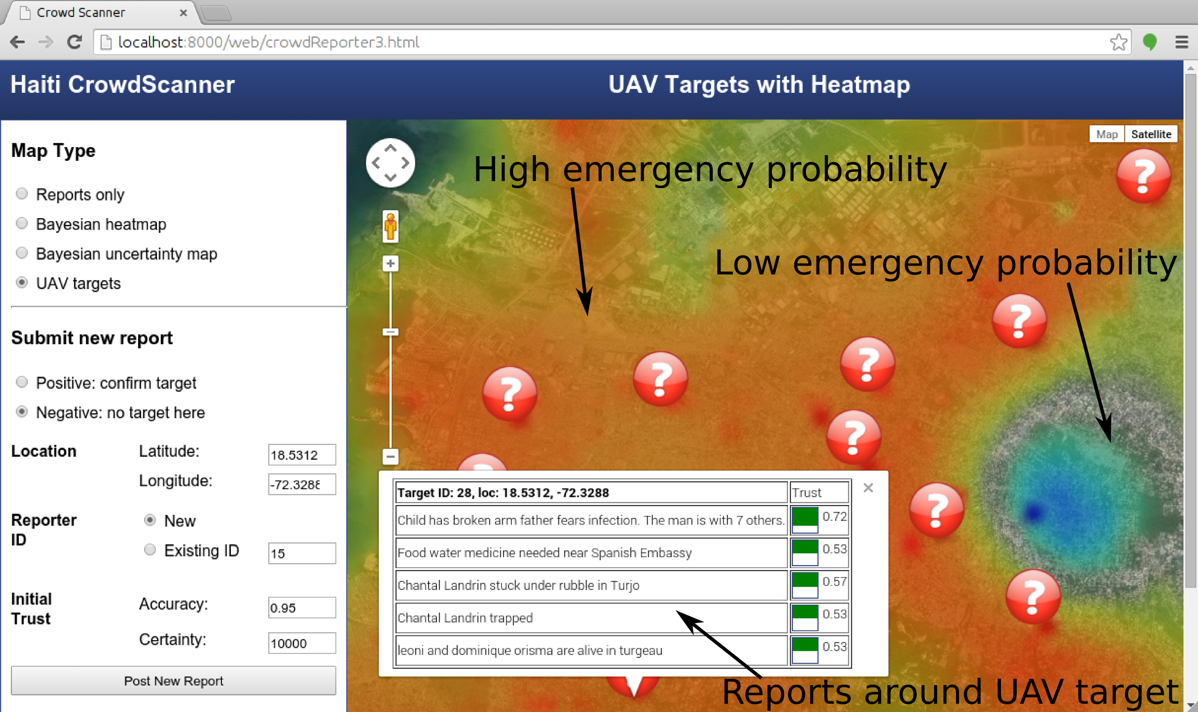

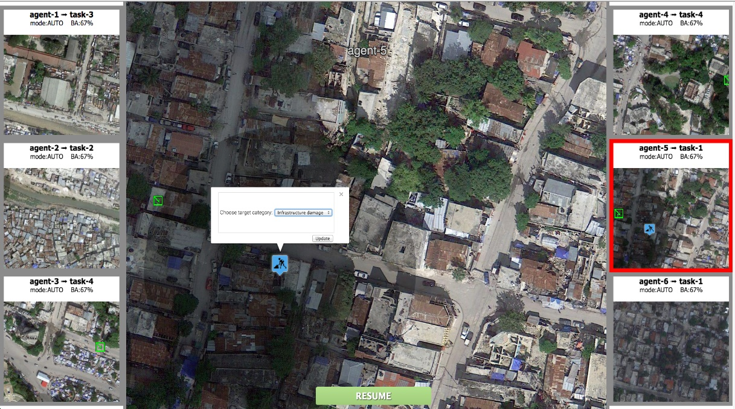
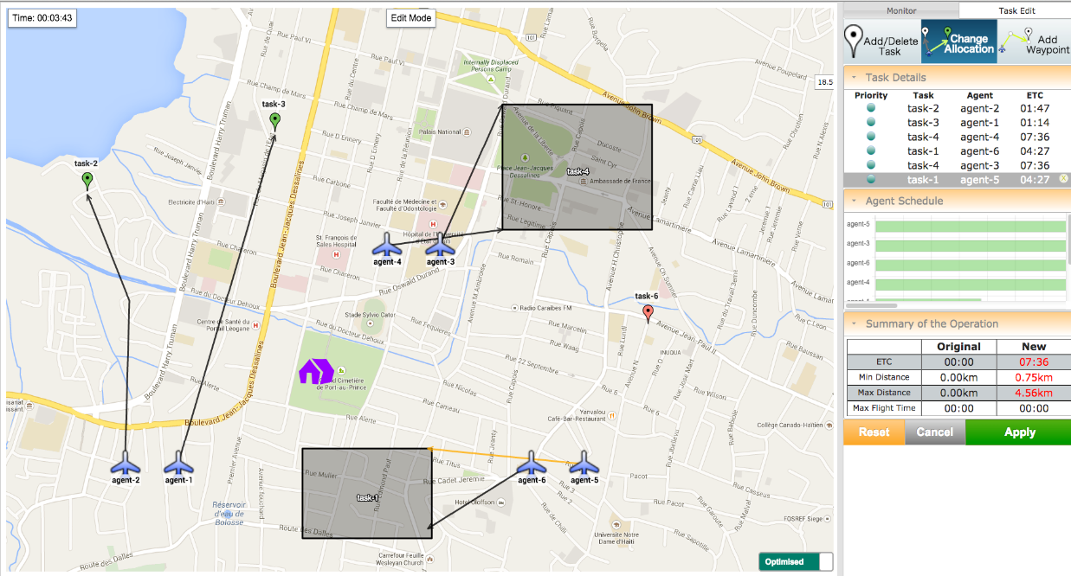
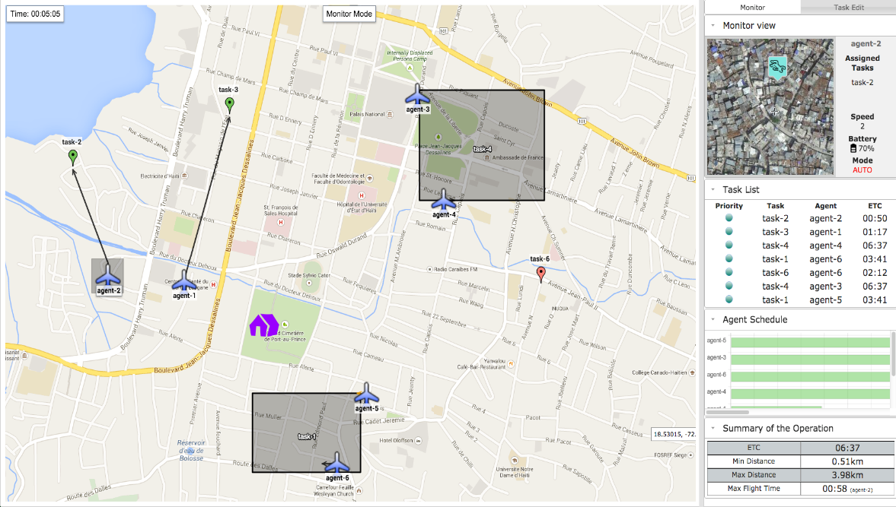
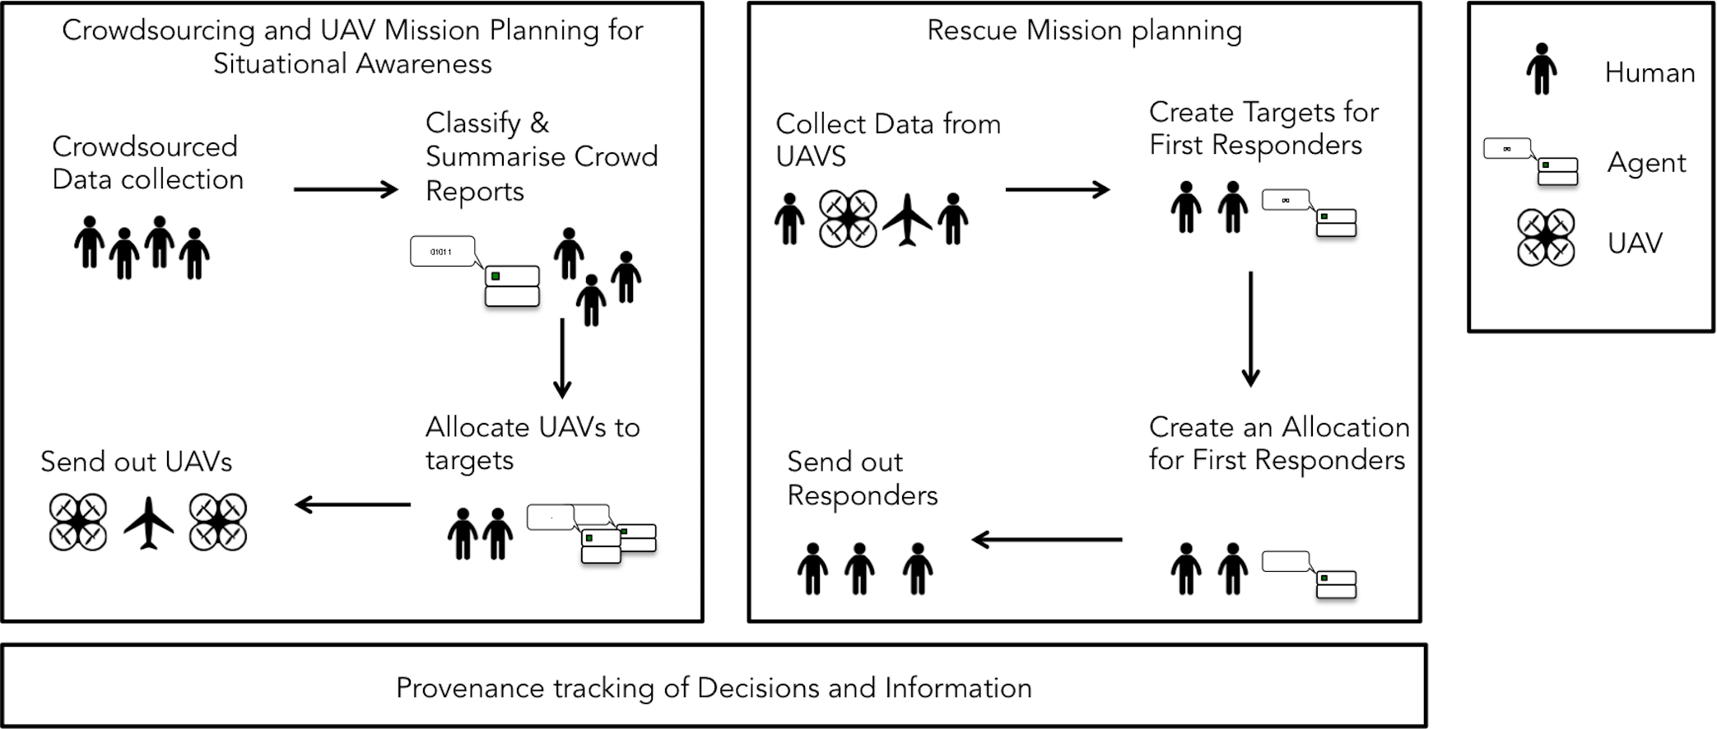


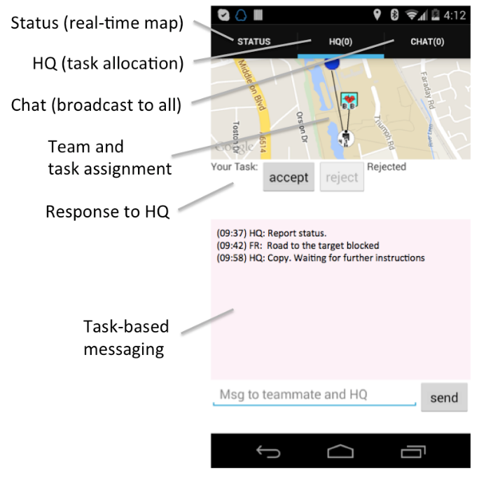
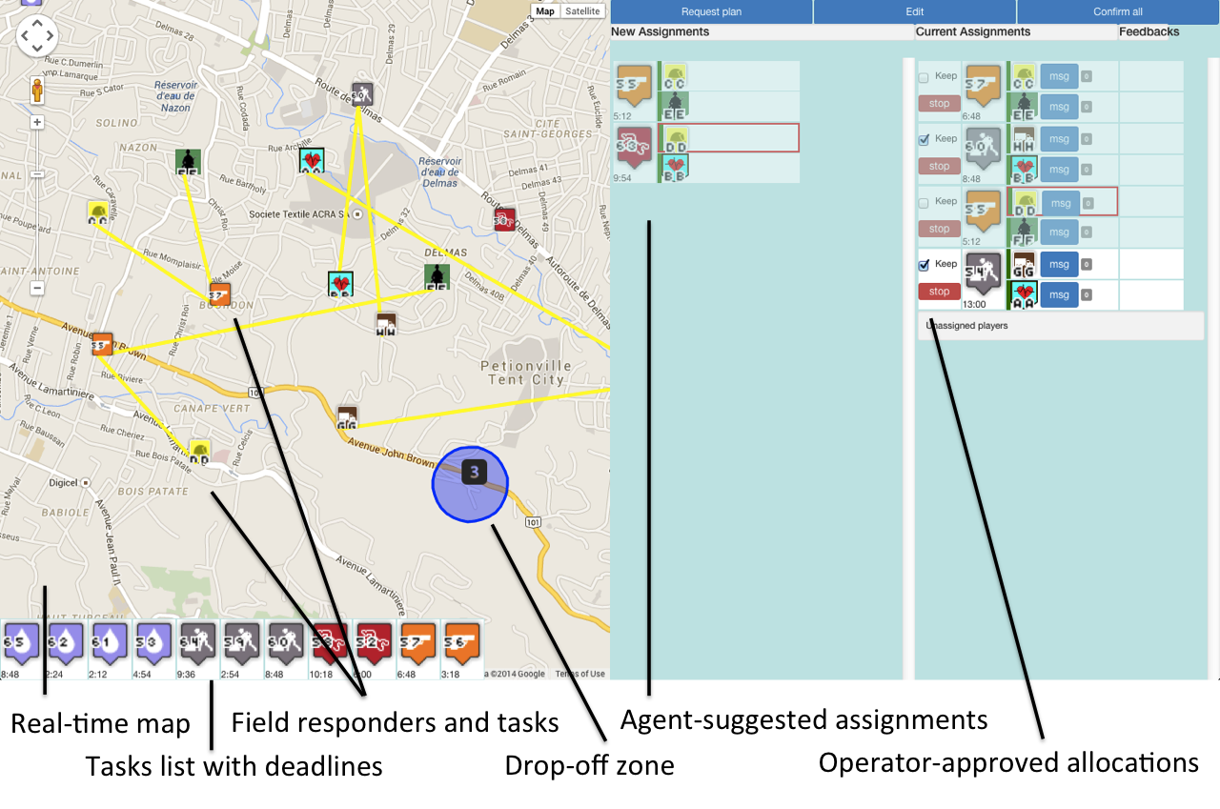
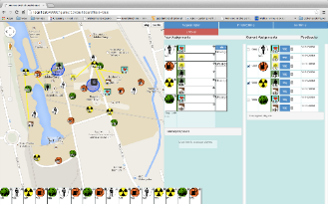

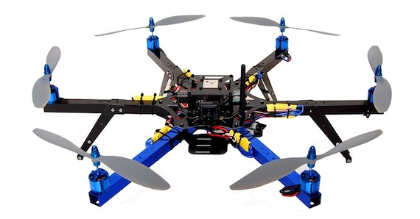
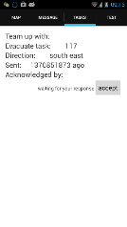
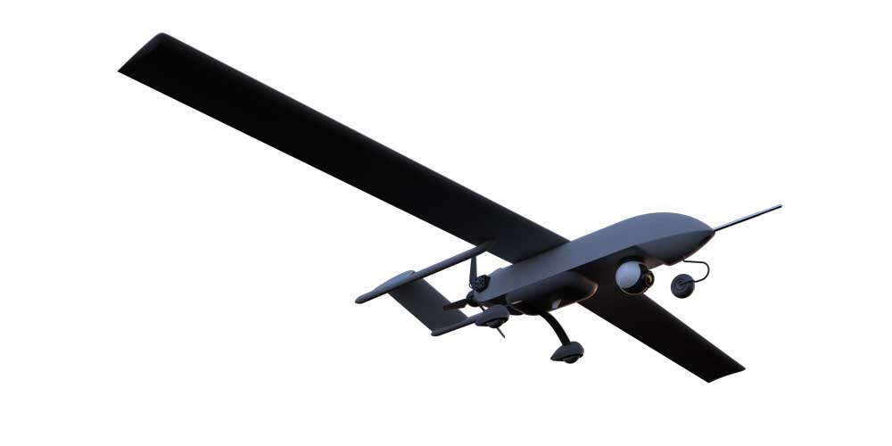

TITLE: Subtitle
Institution | Institution | Institution
Or contact details | or Subtitle 2
Heading 1
Heading 2
Text
Text
Text
(Researcher names): First name, Surname, First name, Surname, First name, Surname, First name, Surname, First name, Surname, First name, Surname, First name, Surname, First name, Surname, First name, Surname,
Heading 2
Text
Text
Text
Heading 2
Text
Text
Text
Heading 1
Heading 1
Text about the image
Heading 2
Text
Text
Text
Heading 2
Text
Text
Text
Heading 2
Text
Text
Text
Heading 2
Text
Text
Text
Heading 1
Camera View
Planner View
Heading 1
UAV Status
Selected UAV Video Feed
Waypoint
Point task
Region task
Edit Modes
Monitor Mode
Unidentified
Target
Resume
/Stop
Max-sum
Allocation
(black line)
Manual
Allocation
(orange line)
Cluster of
Detected
Targets
Plan status
UAV
status
Heading 2
Text
Text
Text
Text
Text
Text
Text
Text:
Heading 2: Text text text
Heading 2: Text text text
Heading 2: Text text text
Heading 2: Text text text
Heading 2: Text text text
Heading 1
Heading 1
Text text text
Bold text
Text
Text
Text
Text
Text
Text
Text
Heading
Text
Text
Text
Heading
Text
Text
Text
Heading
Text
Text
Text
CrowdScanner
HQ Control
Planner Agent
Prov Tracker
Mobile App
UAVs

